Slide 1




Explainable Information Extraction for Data Preparation
11 Months PhD Study Plan
PhD student: Ikhtiyor Nematov
Supervisors : Katja Hose, Tomer Sagi, Dimitris Sacharidis

Slide 2
Outline
Motivation and Background
Objectives and Challenges
Publication Plan
PhD Courses
External Co-operation
PhD Timeline and Status

Slide 3
Outline
Motivation & Background
Objectives and Challenges
Publication Plan
PhD Courses
External Co-operation
PhD Timeline and Status

Slide 4
Key Concepts
Weak Supervision
Influence Function
PhD Project
Information Extraction
Curriculum Learning

Slide 5





Motivation
Influence Function
Weak Supervision
PhD Project
Information Extraction
Curriculum Learning
Mountain of Data
Stock Market
Weather forcast
E-commerce
User Experience
Structured data
Easy to process

Slide 6




Motivation
Influence Function
PhD Project
Information Extraction
Weak Supervision
Curriculum Learning
Structured data
Easy to process
Unstructured data
Scientific papers
Medical notes
Valuable but
hard to process
Government reports
Information Extraction

Slide 7




Information Extraction (IE)
Influence Function
PhD Project
Information Extraction
Weak Supervision
Unstructured Data
Structured Data
Deep Learning model
Curriculum Learning
Training
Machine readable format
Hand Labelling
Semi-supervised learning
Data Augmentation
Transfer Learning
Active Learning
Labeled Data
Weak Supervision

Slide 8
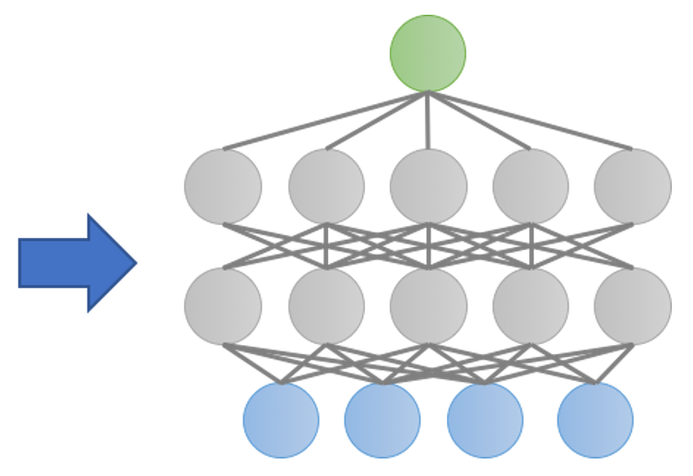
Weak Supervision
Weak Supervision
Influence Function
PhD Project
Information Extraction
Curriculum Learning
Ordinary Supervision
Labeled Data

Slide 9
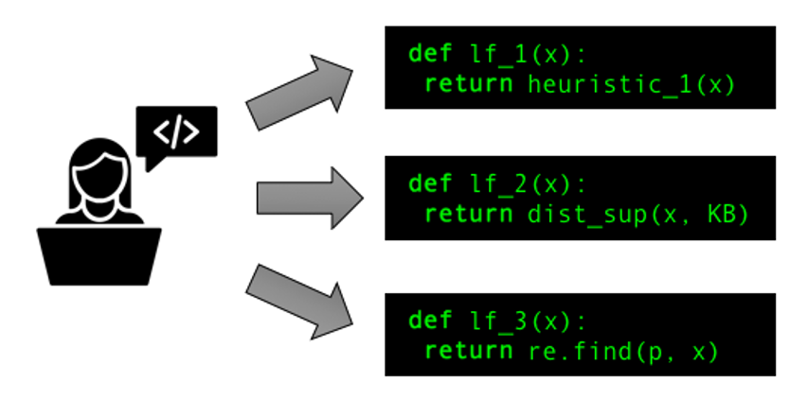
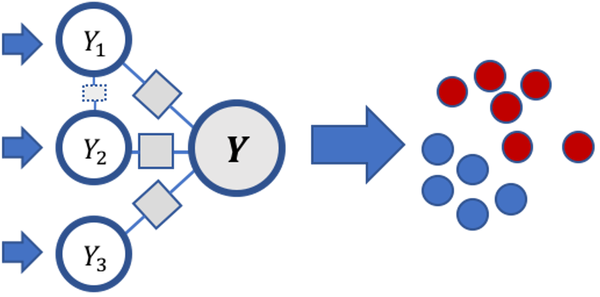
Weak Supervision
Weak Supervision
Influence Function
PhD Project
Information Extraction
Curriculum Learning
Rules
Denoising Mechanism
Noisy Labels
ML-model
Example task:
Is there an association between Chemical and Disease?
INPUT: There were several cases when after taking a Moderna vaccine recipients became fragile to influenza A
OUTPUT: 0/1
Lfi = {
if there’s “became” between Chemical and Disease
Return 1
}
1
Notes:
Pattern-based rules

Slide 10



Curriculum Learning
Influence Function
Weak Supervision
Curriculum Learning
Training ML models in a meaningful order:
from easy data to the hard ones
from easy model to more complex ones
from easy task to the harder ones
PhD Project
Information Extraction
data
data
data
easy
medium
hard
ML model
ML model
ML model
easy
data
data
review or not
medium
easy
data
data
positive or negative
hard
medium
easy
data
data
bad genre or bad acting

Slide 11

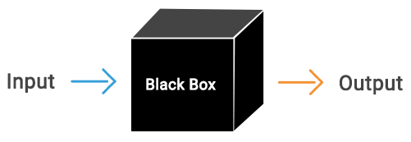
Explainability of ML models
Influence Function
PhD Project
Information Extraction
Weak Supervision
Curriculum Learning
Why has model made this prediction?
Understand model’s behavior and reasoning
Lack of immunity from ethical bias and unfairness
Feature-based explanations
Counterfactuals
Lime
Shapley
Data-based explanations
Data Shapley
Influence function
Because of these features
Because of these training samples
WHY?
WHY?
Explainability

Slide 12

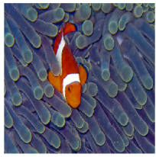
Influence function
Influence Function
PhD Project
Information Extraction
Weak Supervision
Curriculum Learning
Influence score/importance score for each training point
Tool for debugging the models and detecting a bias
Finding errors in the training set
Finding harmful points
Proven to be effective in multistage settings e.g. weak supervision, transfer learning
Influential training examples
Test prediction
SVM
Inception (DNN)
Fish
Notes:
Remove and retrain

Slide 13
Outline
Motivation & Background
Objectives and Challenges
Publication Plan
PhD Courses
External Co-operation
PhD Timeline and Status

Slide 14




Objectives and Challenges
Outcome: Weakly supervised, explainable IE enhanced with curriculum learning
Objective #3: making the IE cost-affordable using weak supervision
Challenges:
How to find the curricula in weak supervision?
Objective #2: enhancing the performance of IE through curriculum learning
Paper 5: Explainable, Weakly Supervised Information Extraction Enhanced with Curriculum Learning.
Challenges:
1) How to deploy explainability in curriculum learning setting?
Objective #1: deploying influence-based explainability for IE
Paper 4: Curriculum Learning in Weak Supervision-based Relation Extraction.
2) How to find the curricula?
Paper 3: Explainability for Curriculum Learning-based Information Extraction.
Challenges:
Issues related to the explanation of influence-based explainability;
How to evaluate the quality of influence-based explanations
Paper 2: Leveraging Hierarchy for Curriculum Learning in GDPR compliance-check Task.
Paper 1: On Evaluating and Improving the Quality of Influence-based Explanations for Information Extraction.

Slide 15

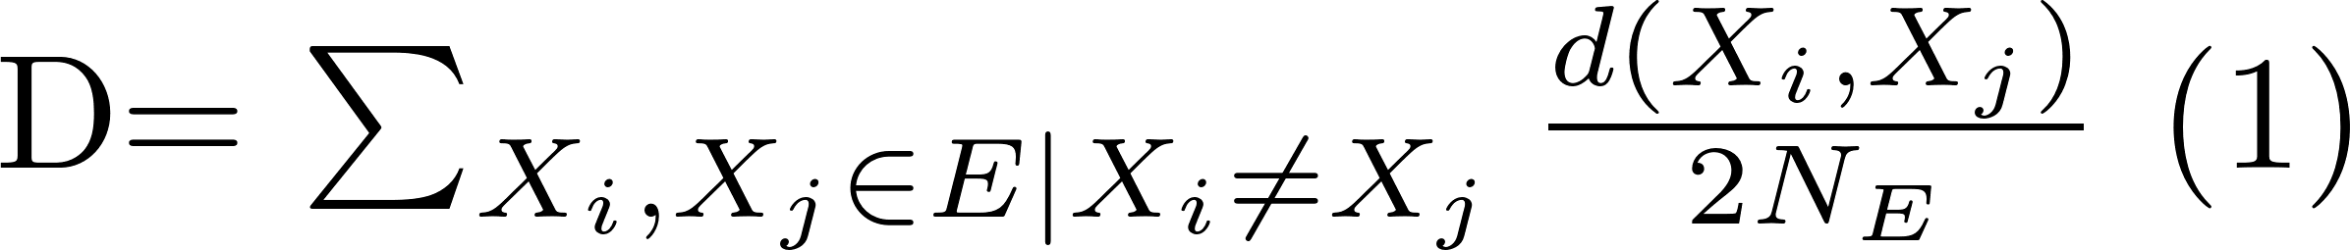
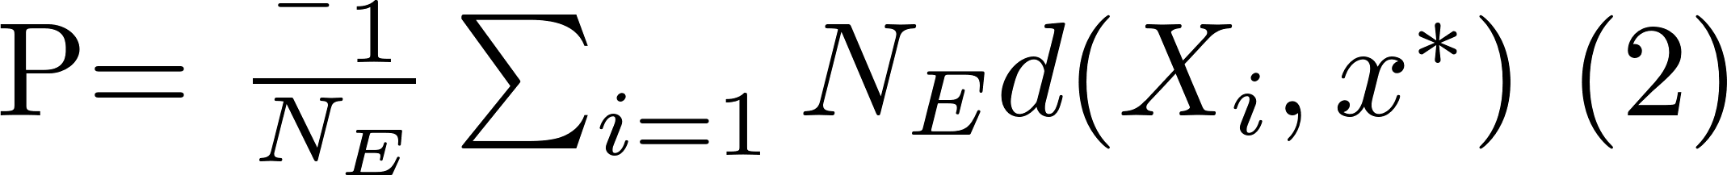
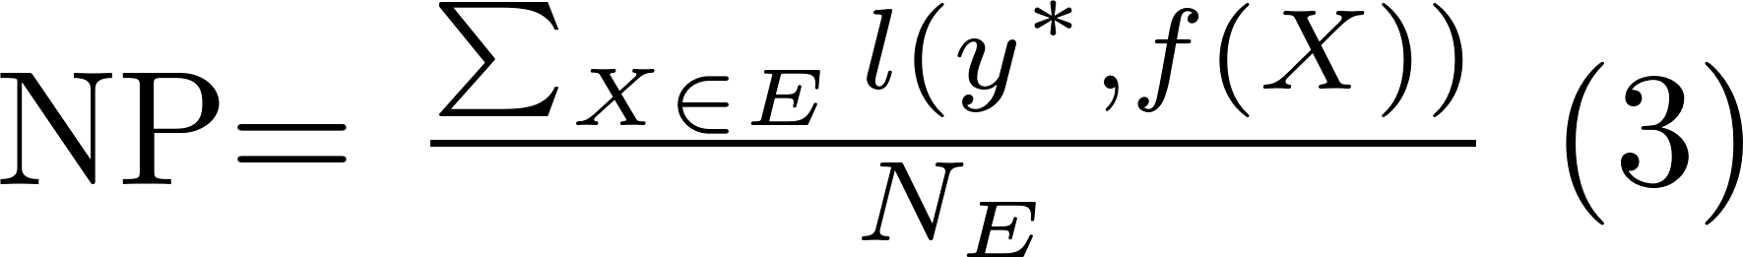
On Evaluating and Improving the Quality of Influence-based Explanations for Information Extraction
Debugging the model, finding and downgrading problematic training samples [Evaluated]
Explaining the prediction for users [not Evaluated]
Existing metrics can not be applied directly
N, the number of examples is not set, score for all training samples is computed instead;
the logic of IF is not the same as other example-based explainability methods:
diversity
proximity
non-representativeness
where E is the set of explanations, NE is the number of explanations, Xi and Xj are explanations, d is the distance metric
x* is the test point of interest
where y* is the prediction of interest

Slide 16
On Evaluating and Improving the Quality of Influence-based Explanations for Information Extraction
'U have a secret admirer who is looking 2 make contact with U-find out who they R*reveal who thinks UR so special-call on 09058094599' | 1
'U have a secret admirer who is looking 2 make contact with U-find out who they R*reveal who thinks UR so special-call on 09058094594' | 1
'U have a secret admirer who is looking 2 make contact with U-find out who they R*reveal who thinks UR so special-call on 09058094565' | 1
'U have a Secret Admirer who is looking 2 make contact with U-find out who they R*reveal who thinks UR so special-call on 09065171142-stopsms-08718727870150ppm' | 1
'U have a Secret Admirer who is looking 2 make contact with U-find out who they R*reveal who thinks UR so special-call on 09065171142-stopsms-08' | 1
'Hello darling how are you today? I would love to have a chat, why dont you tell me what you look like and what you are in to sexy?' | 1
'Will u meet ur dream partner soon? Is ur career off 2 a flyng start? 2 find out free, txt HORO followed by ur star sign, e. g. HORO ARIES' | 1
congrats 1 year special cinema pass is yours call 09061209465 now c suprman v matrix3 starwars3 etc all 4 free bx420 ip4 5we 150pm dont miss out ' | 1
'how come it takes so little time for a child who is afraid of the dark to become a teenager who wants to stay out all night ' | 1
'We know someone who you know that fancies you. Call 09058097218 to find out who. POBox 6, LS15HB 150p' | 1
'Dhoni have luck to win some big title.so we will win:)' | 0
Test Prediction: 1 'U 447801259231 have a secret admirer who is looking 2 make contact with U-find out who they R*reveal who thinks UR so special-call on 09058094597'
Problems:
Not diverse, with repetitions
Confusing counterfactuals
Irrelevant examples

Slide 17


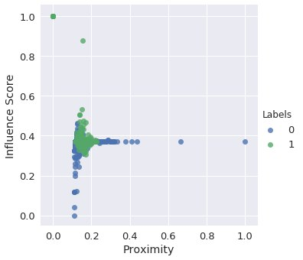


On Evaluating and Improving the Quality of Influence-based Explanations for Information Extraction
GOAL:
N*
Maximal Influence
Minimal Proximity
Maximal Diversity
Minimal NP

Slide 18
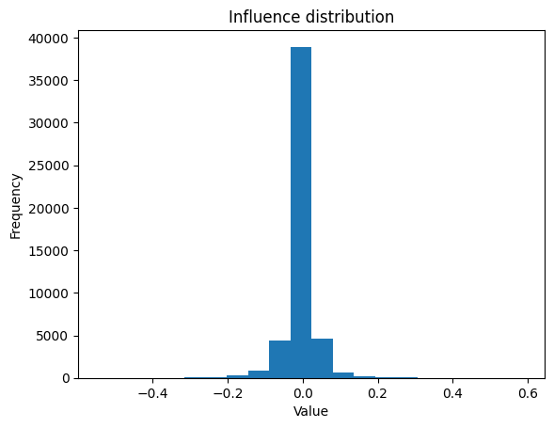
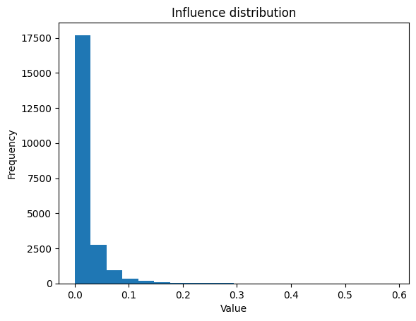
On Evaluating and Improving the Quality of Influence-based Explanations for Information Extraction
Very small set with an actual/ influence
Points with a positive influence
whole dataset = 50 000
positive influence = 22106

Slide 19
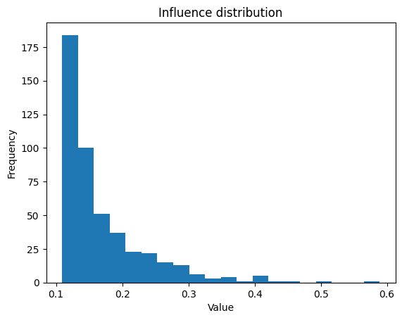
On Evaluating and Improving the Quality of Influence-based Explanations for Information Extraction
Outlier detection problem
Inter quartile range (IQR) since it is a skewed distribution:
𝐼𝑄𝑅 = 𝑄3 − 𝑄1
𝑡ℎ𝑟𝑒𝑠ℎ𝑜𝑙𝑑 = 𝑄3 + 3 ∗ 𝐼𝑄𝑅 where 𝑄1 and 𝑄3 are the first and the third quartile, or 25th and 75th percentile respectively.

Slide 20
On Evaluating and Improving the Quality of Influence-based Explanations for Information Extraction
Diverse subset selection with constraints (Influence, Proximity, and Non-Representativeness)
Greedy algorithm (the element with max influence is used for initialization)
GOAL:
N*
Maximal Influence
Minimal Proximity
Maximal Diversity
Minimal NP

Slide 21
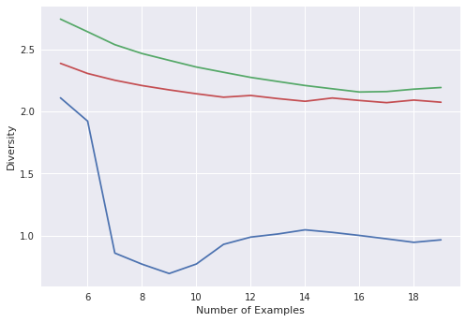
On Evaluating and Improving the Quality of Influence-based Explanations for Information Extraction
Test Prediction: 1 'U 447801259231 have a secret admirer who is looking 2 make contact with U-find out who they R*reveal who thinks UR so special-call on 09058094597'
'u have a secret admirer who is looking 2 make contact with u find out who they r reveal who thinks ur so special call on 09058094565' | 1
'hello darling how are you today i would love to have a chat why dont you tell me what you look like and what you are in to sexy ' | 1
'oh my god i ve found your number again i m so glad text me back xafter this msgs cst std ntwk chg 1 50' | 1
'someone u know has asked our dating service 2 contact you cant guess who call 09058095107 now all will be revealed pobox 7 s3xy 150p ' | 1
'we know someone who you know that fancies you call 09058097218 to find out who pobox 6 ls15hb 150p' | 1
'our dating service has been asked 2 contact u by someone shy call 09058091870 now all will be revealed pobox84 m26 3uz 150p' | 1
'someone u know has asked our dating service 2 contact you cant guess who call 09058095107 now all will be revealed pobox 7 s3xy 150p ' | 1
'valentines day special win over 1000 in our quiz and take your partner on the trip of a lifetime send go to 83600 now 150p msg rcvd custcare 08718720201' | 1
'ever thought about living a good life with a perfect partner just txt back name and age to join the mobile community 100p sms ' | 1
'ever thought about living a good life with a perfect partner just txt back name and age to join the mobile community 100p sms ' | 1
'our dating service has been asked 2 contact u by someone shy call 09058091870 now all will be revealed pobox84 m26 3uz 150p' | 1
-- IF -- DIF -- DIF_NP
Notes:
Combined/harmonic metric

Slide 22

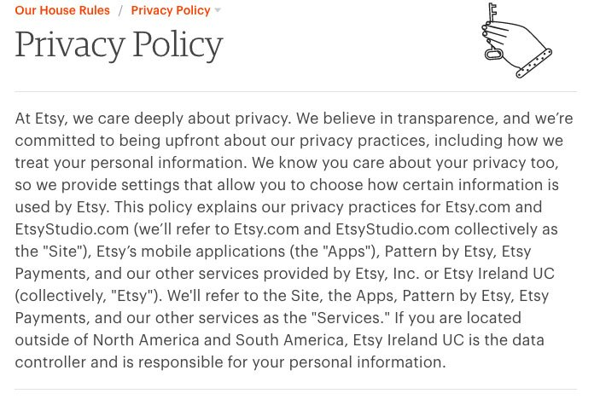


Leveraging Hierarchy for Curriculum Learning in GDPR compliance-check Task
Given a privacy policy of a company identify whether it is GDPR-compliant or not
Multiple level of granularity
GDPR has 7 principles
categories
attributes
Deep Learning model

Slide 23
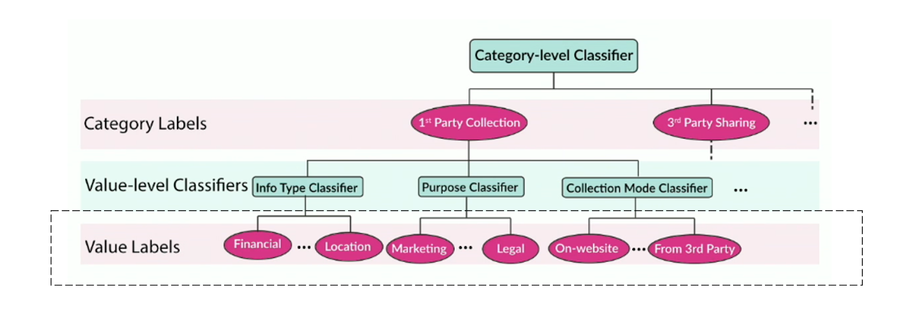
Leveraging Hierarchy for Curriculum Learning in GDPR compliance-check Task
Leverage the hierarchy in the structure of a privacy policy through task-level curriculum learning
OPP-115 dataset
115 privacy policies, manually annotated by the domain expert on a paragraph level => 3 792 paragraphs, 10-12 high-level classes and 22 distinct low-level attributes.

Slide 24

Explainability for Curriculum Learning-based Information Extraction
How does the set of influential points for a specific prediction changes with respect to the task difficulty?
For a hard data point will the influential training points be also hard points?
Training samples with negative influence will be eliminated in each round before moving to the next training
data
easy
medium
hard
easy
medium
easy
Harmful points
hard
medium
easy
Harmful points
Notes:
Following research questions will be answered

Slide 25

Curriculum Learning in Weak Supervision-based Relation Extraction
Rules are written by experts, their difficulty can be assigned as well
Exploring the curricula of data through the difficulty of the rule that has given the label
Lfi = {
if there’s “became” between Chemical and Disease
Return 1
}
There were several cases when after taking a Moderna vaccine recipients became fragile to influenza A => 1
Lfi = { if there’s “became” between ChemicalA and DiseaseB
AND There’s no “no evidence” or synonims
Return 0 }
Our study has shown no evidence that after parental magnesium administration patient became quadriplegic => 0

Slide 26

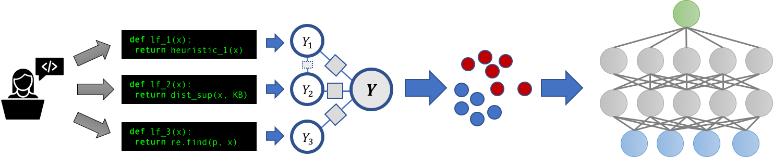
Explainable, Weakly Supervised Information Extraction Enhanced with Curriculum Learning
Extends our previous works
Eliminate harmful/wrong points
Eliminate harmful points

Slide 27
Outline
Motivation & Background
Objectives and Challenges
Publication Plan
PhD Courses
External Co-operation
PhD Timeline and Status

Slide 28
Tentative Publication Plan
On Evaluating and Improving the Quality of Influence-based Explanations for Information Extraction
Type: Conference Outlet: ECML 2023 Time: March 2023
Leveraging Hierarchy for Curriculum Learning in GDPR compliance-check Task
Type: Conference Outlet: ICDE 2024 Time: September 2023
Explainability for Curriculum Learning-based Information Extraction
Type: Conference Outlet: SIGIR 2024 Time: January 2024
Curriculum Learning in Weak Supervision-based Relation Extraction
Type: Conference Outlet: NIPS 2024 Time: June 2024
Explainable, Weakly Supervised Information Extraction Enhanced with Curriculum Learning
Type: Journal Outlet: JMLR 2025 Time: November 2024

Slide 29
Outline
Motivation & Background
Objectives and Challenges
Publication Plan
PhD Courses
External Co-operation
PhD Timeline and Status
Notes:
Take a break, Now I would love to talk about formal stuff

Slide 30
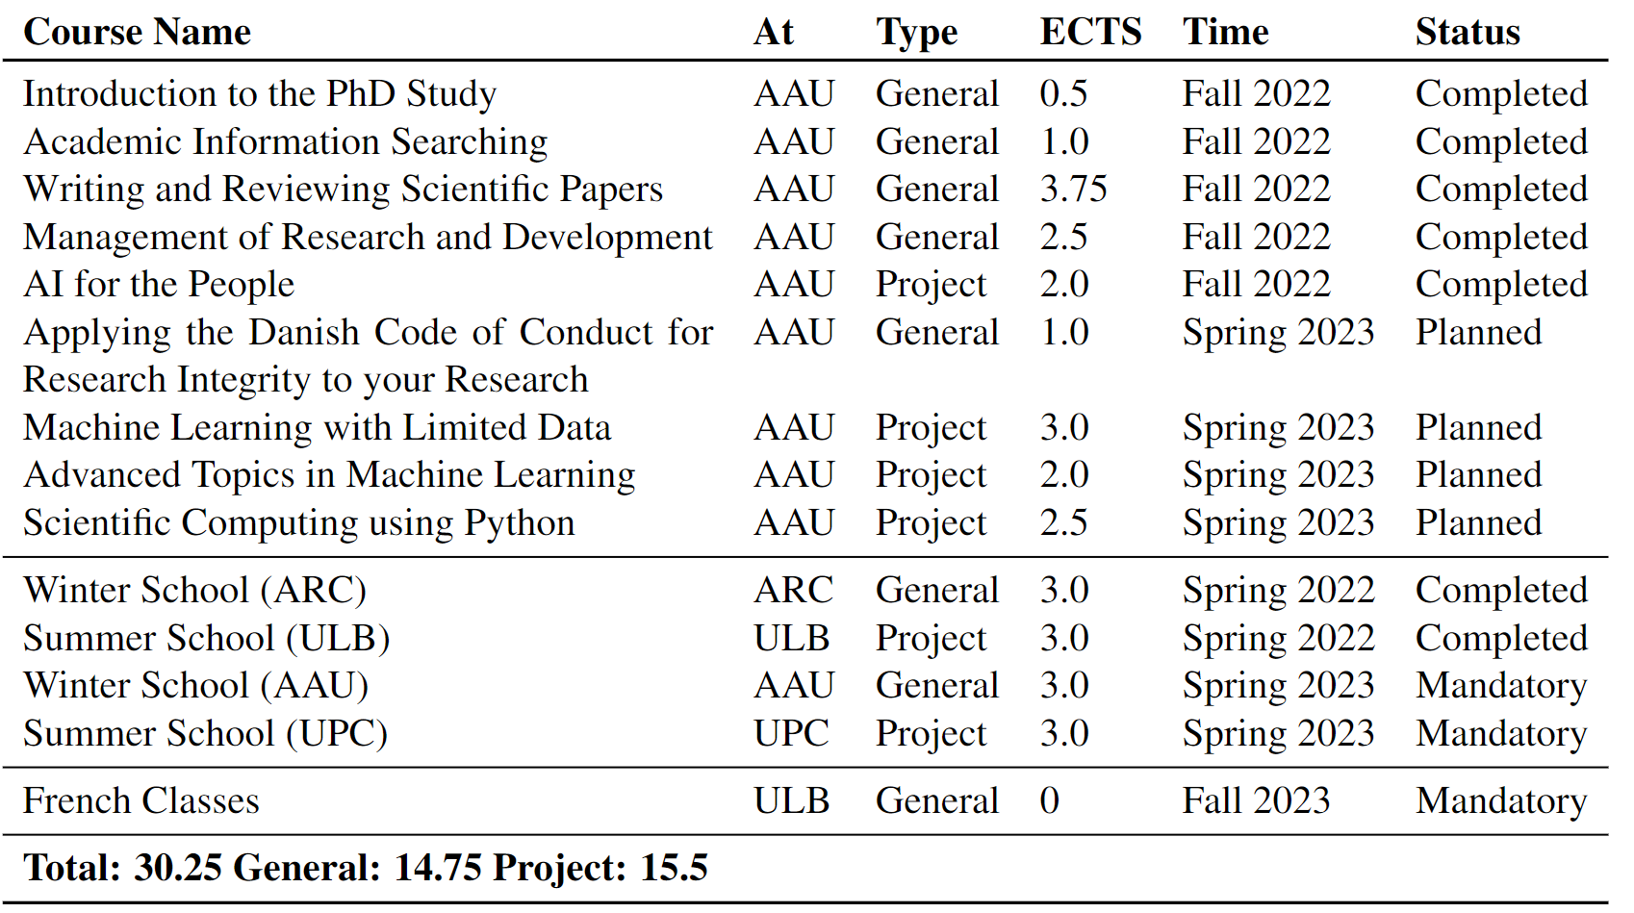
PhD Courses
Completed ECTS: 14.75
Remaining ECTS: 16

Slide 31
Outline
Motivation & Background
Objectives and Challenges
Publication Plan
PhD Courses
External Co-operation
PhD Timeline and Status

Slide 32


External Co-operation
1 semester
Spring 2022
2 semesters
Fall 2022,
Spring 2023
3 semesters
Fall 2023,
Spring 2024,
Fall 2024
Internship at Euranova, Brussels for 3 months [September-November, 2023]
Planned work in collaboration “Leveraging Hierarchy for Curriculum Learning in GDPR compliance-check Task”
Notes:
Joint programm

Slide 33
Outline
Motivation & Background
Objectives and Challenges
Publication Plan
PhD Courses
External Co-operation
PhD Timeline and Status

Slide 34


PhD Timeline and Status
1st Paper
2nd Paper
3rd Paper
4th Paper
2nd Paper
2 months plan
11 months plan
Start
Thesis
Feb 2022 Sep 2022 Feb 2023 Sep 2023 Feb 2024 Sep 2024 Feb 2025
Winter school
Summer school
Winter school
Summer school

Slide 35
Thanks for your attention
Q&A

